Slide 1

Welcome to PHYSICS 365
This is section: L01
Lectures: TR 12:30–13:45, ENG 60

Slide 2
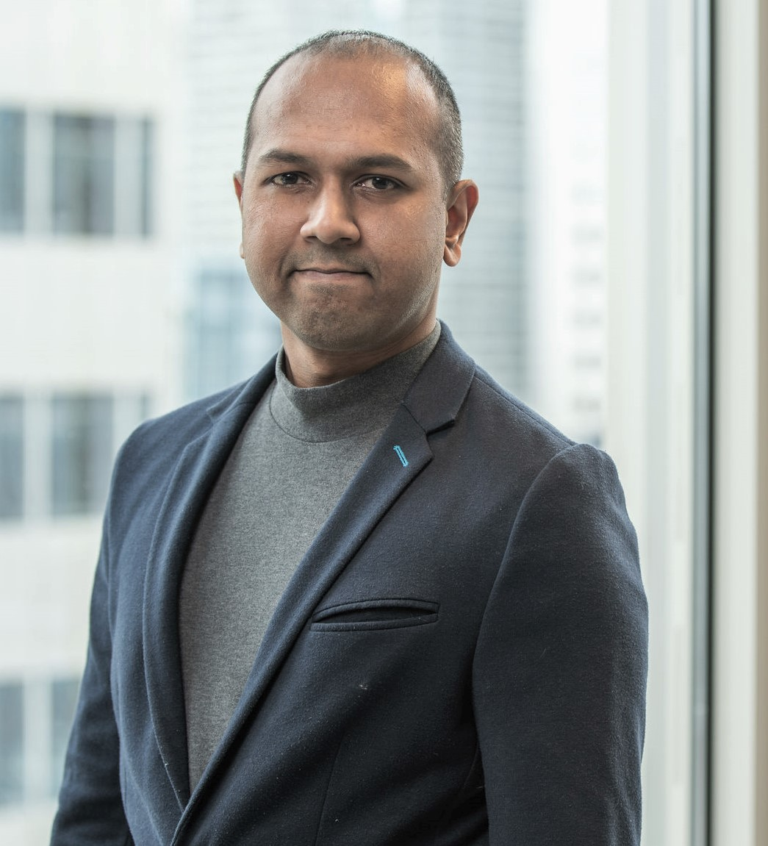
A Little About Me
Research interests:
  Mathematical Physics
Corporate Experience:
  Banking and Financial Institutions
  Engineering R&D: commercial power generation
Dr. Tim Andrew (course instructor)
Office: Science B - 307
Email: timothy.andrew@ucalgary.ca
Office hours: T 1400 – 1500 MT at SB 307

Slide 3
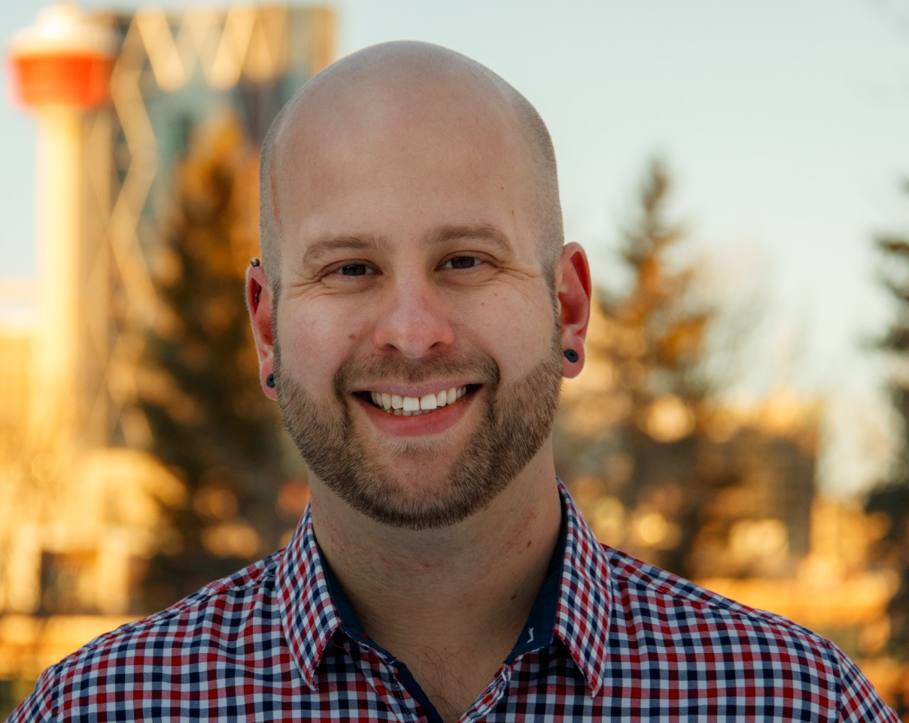
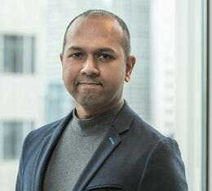
PHYS 365/369 Coordinator Team
Lecture Coordinator:
Dr. Sean Stotyn
Lab Coordinator:
Dr. Timothy Andrew
phys365369coord@ucalgary.ca
Use your official UCALGARY email account for ALL emails!
In the email, include your full name, course & lecture (or lab) section, & UCID
Attach supporting documents when needed. If contacting about a missed course component or a scheduling conflict, fill out the appropriate form on D2L first and wait for a response.
Be clear and precise: There are ~650 students to attend to in PHYS 365/369
Expect a response within 2 business days (might be longer during first few weeks of classes).
DO NOT RE-SEND THE SAME EMAIL MULTIPLE TIMES

Slide 4
PHYS 365 & 369 Course Grade Rubric
Component | Weight [%] | Notes
Labs + Pre-Lab Quizzes | 25 | See course outline and lab d2l shell for more info
Assignments (10) | 25 | Due @ 11:59pm on Due Date (NO LATE ASSIGNMENTS)
Midterm Examination | 20 | Wednesday October 21, 7:00-8:30 PM
Final Examination | 30 | In person, to be scheduled by Registrar.
Total | 100
Check your grades on D2L regularly.
Any discrepancies should be reported within 15 days from the day a grade has been posted to the TA (labs) or the course coordinator (all other)
http://www.ucalgary.ca/pubs/calendar/current/i-2.html

Slide 5
Physics 365 D2L Course Shell
PHYS 365 Fall 2026 - Acoustics, Optics and Modern Physics (for students in Engineering)*
  Course outline and Lecture/Lab schedule
  Course announcements
  Forms for missed components/conflicts
  Grades
  Course notes (PPT slides, scanned notes, etc.)
  Practice exams and practice problems
  Formula Sheet
  Extra notes (EN) and Openstax (OS) resources
  Additional resources
4
Notes:
4

Slide 6
Textbook & Achieve Code
OpenStax “University Physics” Vols 1 and 3 and supplemental Extra Notes (posted to D2L)
Same book & Achieve used for PHYS 259 in W2026.
If you purchased a 2-term access code in W2026 then you will be able to use it this semester too.
  If you re-took PHYS 259 this past summer, that will NOT have used your 2nd term of access, so you can still use your 2-term code for this course. If you run into trouble, contact the course coordinator.
If you purchased a 1-term access code in W2026, you will need to purchase another term, or you will be able to access the homework on the computers in TFDL free of charge if you choose to do so.

Slide 7
AI Homework Tutor Chatbot on Achieve
There is an AI tutor on Achieve that is trained on the course material.
It is aimed at guiding you through the homework problems in a constructive way to help you learn.
When you encounter problems understanding the homework questions, you are encouraged to try using it as a first step. It gives hints and uses Socratic questioning to support your learning.

Slide 8
Missed course components/conflicts
Download the appropriate Excel form for a missed course component or time conflict and fill it out completely.
Submit the filled-out Excel file to the appropriate dropbox on D2L.
Wait for a response from the course coordinator.
Note: only submit the form in .xlsx format. If you have not received a response within one week, contact the course coordinator; do not submit the form again.

Slide 9
University Important Dates:
Drop Date (no financial penalty): Thursday, September 10
Add Date: Friday, September 11
Fee payment Date: Friday, September 18
Withdrawal Date: Friday, December 4
See https://www.ucalgary.ca/registrar/academic-dates for all dates/holidays etc
Important Course Dates:
Midterm Exam: Wednesday, October 21, 7:00-8:30 PM (location TBA)
Final Exam: Sometime between December 8-18
DO NOT MAKE TRAVEL PLANS UNTIL THE FINAL EXAM SCHEDULE IS PUBLISHED

Slide 10
Resources Available
There are many resources offered that can help you through difficult spots:
Neurodiverse and want to explore your options and accommodations? Visit Student Accessibility Services: https://www.ucalgary.ca/student-services/access
Want more info on programs or services regarding Physical and/or Mental Health? https://www.ucalgary.ca/wellness-services and https://ucalgary.ca/mentalhealth/get-support/students
Self-help resources to stay on top of your mental well-being: https://www.ucalgary.ca/wellness-services/services/mental-health-services/self-help-resources
Need help with academics? Visit the Student Success Centre https://www.ucalgary.ca/student-services/student-success
Need academic improvement? https://www.ucalgary.ca/student-services/student-success/advising/academic-improvement
Need a tutor? https://www.su.ucalgary.ca/programs-services/student-programs/tutors/

